Slide 1
Proposed Orange County
Micromobility Devices Ordinance
Public Hearing
September 29, 2026

Slide 2
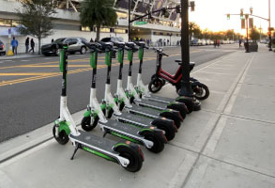
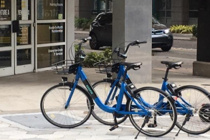
Presentation Outline
Background and Overview
Public Awareness and Concerns
Public Education
Micromobility Legislation
Proposed Ordinance
Summary
Board Direction

Slide 3
Background and Overview
Commissioner’s Report: December 2, 2025
  Discussed rapid growth of micromobility use in Orange County
BCC Direction
  Evaluate micromobility safety issues and concerns
  Coordinate with partners
  Return with recommendations
BCC Work Session: May 19, 2026
  Spearheaded multiple working groups and collected feedback identifying issues and needs
  Recommendations included Public Education, Safety & Infrastructure Study and development of an Ordinance
Notes:
Commissioner Report:
Discussed during 12/2/25 BCC meeting2025 (Commissioner Nicole Wilson, District 1)
Rapid growth of micromobility use requires action
Ensure safe mobility for residents and visitors while preserving transportation options
Development of evidence-based safety requirements and commissioning of a comprehensive research and enforcement capacity study
Immediate, midterm and long-term policy recommendations including draft ordinance language
Public engagement plan and pilot program recommendations
Budget, staffing and implementation needs
BCC Direction:
Evaluate micromobility safety issues and concerns
coordinate with partners; return with recommendations.
BCC Work Session May 19:
Enhance Public Education: Partner with stakeholders to launch educational campaigns specifically targeting youth and utilizing point-of-sale distribution. (Immediate, then ongoing)
Conduct a Safety Study and Infrastructure Improvements: Proceed with a comprehensive assessment to include infrastructure needs, future network planning, and potential capital priorities, with short term high impact safety improvements. (Short-term to long-term)
Consider development of a County-wide Micromobility Ordinance: Immediately incorporate SB 382 (2026) and consider recommended provisions in a draft ordinance and continue refinement of the ordinance by collaborating with regional partners to establish a scalable model for the region; return within three months for a work session with the Board to present draft ordinance. (Short-term)

Slide 4
Presentation Outline
Background and Overview
Public Awareness and Concerns
Public Education
Micromobility Legislation
Proposed Ordinance
Summary
Board Direction

Slide 5
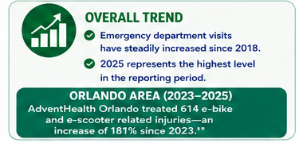
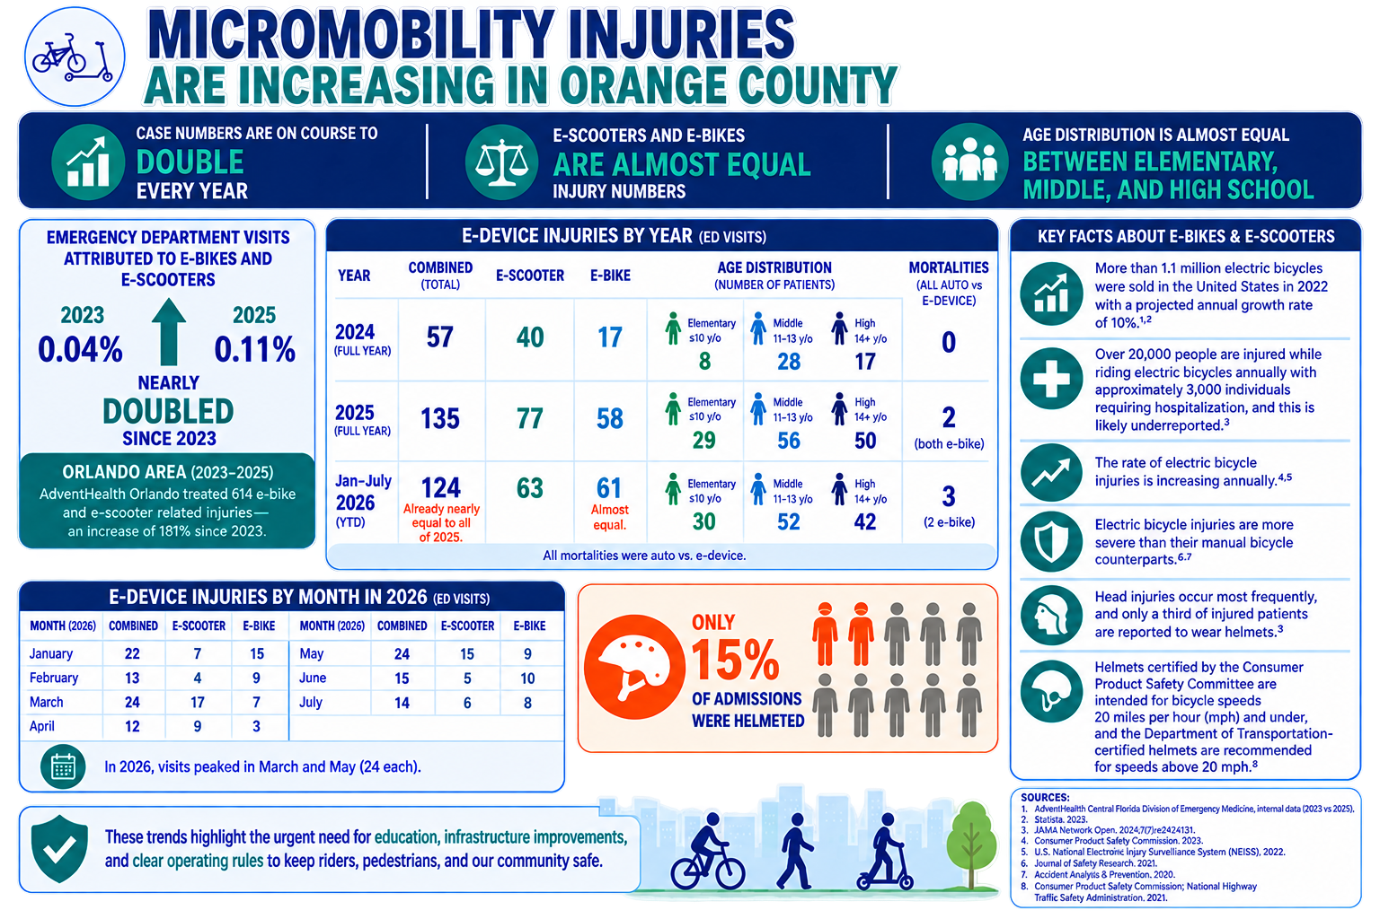
Public Awareness and Concerns
Source: AdventHealth
Source: Orlando Health
Notes:
When access to e-scooters and e-bikes was generally limited to shared fleets, many of the headlines centered around recommendations for people to wear helmets and have some practice using the devices, especially the e-scooters, before venturing too far from a parking lot or other isolated area. The design of e-scooters also evolved to have bigger wheels and other features that reduced some crash types.
Now that access has expanded, especially to younger people who may not have a full understanding of the rules of the road, emergency rooms across the region are seeing a surge in ER visit related to e-bike and e-scooter use.
Critical Safety Data & Education Needs
Youth Risk: 54% of emergency visits for micromobility crashes involve youth (age 19 and younger); 28% involve children ages 10–14.
Shared Network Challenges: Differing levels of understanding among riders, motorists, and pedestrians regarding laws and safe operating practices.
Key Topics: Focus on helmet/yielding requirements, device classification, safe passing, and shared-use path etiquette.
124 cases Jan–July 2026 — already nearly equal to all of 2025 (135)
E-scooters and e-bikes are nearly evenly split — 63 vs. 61 in 2026
Age groups are relatively evenly distributed — Elementary 30, Middle 52, High 42
3 mortalities in Jan–July 2026, compared with 2 in all of 2025
Only 15% of admissions involved helmeted riders
Add a concise 2024 → 2025 → 2026 trend visual to make the growth immediately apparent
Key Takeaway
Micromobility use is increasing rapidly. National research, Orange County data, and Central Florida trauma centers all show rising injuries—particularly among children
and teenagers—highlighting the need for education, safer infrastructure, and responsible riding.

Slide 6
Presentation Outline
Background and Overview
Public Awareness and Concerns
Public Education
Micromobility Legislation
Proposed Ordinance
Summary
Board Direction

Slide 7

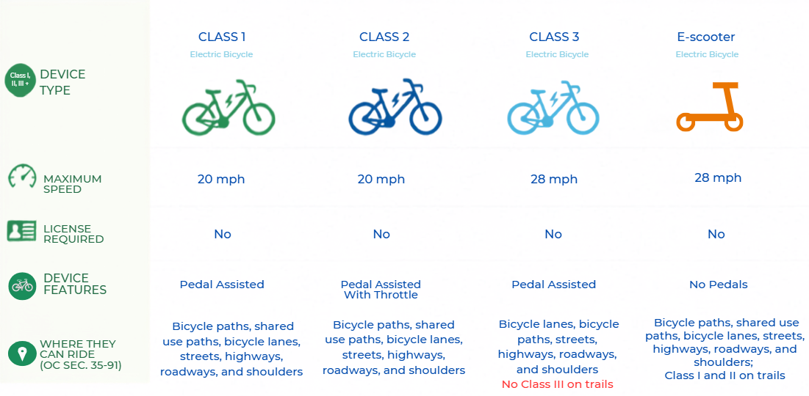
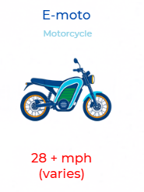
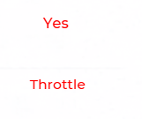


Background and Overview
Public Education
Not Micromobility
Notes:
*Class 3 not allowed on Trails**
Challenges with the Current Class 1–3 E-Bike Classification System:
Only Class 1, 2, and 3 e-bikes are defined in Florida law.
Many newer devices do not fit into the Class 1–3 system.
High-powered e-motos and modified e-bikes are often mistaken for legal e-bikes.
Enforcement is difficult because officers cannot easily identify a device's classification.
Modified devices can exceed legal speed limits while appearing to be standard e-bikes.
Consumers are often confused about which devices are legal and where they may be operated.
Adding changes regarding what is allow and where…

Slide 8










Public Education: Road Users
Lack of Data
Provide resources for equipment, safe riding training and advocacy
Device Classifications
Safe Speeds around riders
Yielding requirements
Helmet requirements
Nighttime/Predawn visibility requirements
Trail Etiquette
Impaired/Distracted Driving
Notes:
Transition/Intro: Public education is an important .
We want to make sure that safety information reaches all three groups involved in micromobility: riders, pedestrians and motorists.
For riders, the focus is on understanding the rules of the road, safe riding, equipment and responsible operation.
There are already several organizations in Florida that can help deliver this education.
FDOT, ABEA, Safe, Bike/Walk CF, Children’s Safety Village, AAA, Florida Bicycle Association, law enforcement and local governments all have existing safety education platforms that can be leveraged.
The challenge is to make that education more specifically applicable to today's micromobility devices—particularly e-bikes and e-scooters.
These organizations provide resources that include: equipment, safe riding training and advocacy, while making sure young riders understand where and how these devices can legally operate.
There is no “one-stop shop” when it comes to seeking information and resources on micromobility or traditional bike usage. Greater coordination is needed.

Slide 9






Public Education: Road Users
Crossing, visibility & interaction with bikes/e-bikes, education, advocacy
Shared use path etiquette
Shared use path etiquette
Awareness of approaching riders
Understanding audible warnings (“On your left”)
Awareness of nighttime/predawn visibility
Notes:
For pedestrians, particularly on sidewalks and shared-use paths, the focus is on awareness, visibility and safe interactions with e-bikes and other devices.
As micromobility use increases, pedestrians are increasingly sharing sidewalks and multi-use paths with faster-moving devices which also includes traditional bikes.
Here, FDOT, Safe Routes to School, law enforcement and MetroPlan Orlando, Florida Bicycle, and Children’s Safety Village already have pedestrian-safety education programs that can be expanded to address micromobility.
The emphasis should be on crossing, visibility and interaction with e-bikes and e-scooters, along with basic expectations for both pedestrians and riders when sharing these spaces.
This is particularly important for children and families, who may be both pedestrians and micromobility users during the same trip.
So Central Florida does not necessarily need to start from scratch. We already have organizations, programs and communication channels in place. The opportunity is to bring those efforts together and make micromobility a more explicit part of the safety message—for riders, motorists and pedestrians.

Slide 10





Public Education: Road Users
Awareness of e-devices
Sharing the road safely
Safe passing practices
Looking for riders at intersections and driveways
Understanding where e-devices can legally ride
Driver responsibilities around vulnerable road users
Safe passing practices
Share-the-road, yielding, passing & awareness
Notes:
For motorists, the emphasis is on awareness—recognizing micromobility users, yielding appropriately and sharing the road safely.
Motorist education is equally important because a safe transportation system requires both drivers and vulnerable road users to understand how to interact with one another.
Florida already has organizations such as FDOT, FLHSMV, AAA and law enforcement providing Share the Road and vulnerable-road-user education.
The opportunity is to help the largest number of of road users-motorists understand yielding, passing, visibility and awareness, particularly around intersections, schools, bike lanes and shared-use paths.
The gap: Education is still relatively fragmented, and e-bike-specific education—particularly for motorists and pedestrians—is newer and less developed than traditional bicycle/pedestrian safety education. MetroPlan's own research notes that education on proper e-micromobility behaviors remains limited.

Slide 11


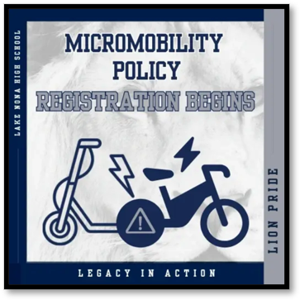

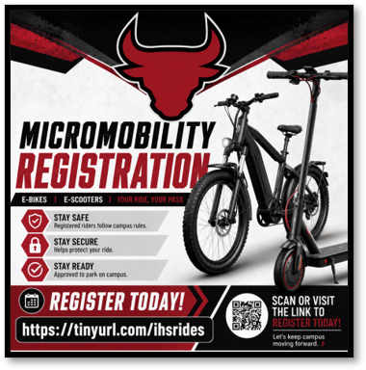
Public Education: OCPS
E-device Parking Management and Education pilot program
  Parents and students must register their device and upload a picture of the device and read and certify device is “street legal”
  Program occurred during the 2025-26 school year
E-device Safety Education Pilot Program
  Luminary MS and Timber Springs MS
  60 min training
  Completed in class: This drives completion
  Self-paced online course through OCPS Launchpad and Canvas
OCPS Micromobility Policy: (Effective September 8, 2026)
  Student riders must have learner’s permit or driver’s license to bring class I and II e-devices to campuses
  High Schools now require registration/decals
80%
Notes:
- No issue currently identified with devices yet in the ROW; any future safety concerns will need support from OCSO, OCSO discretion whether to impound
“OCPS staff had begun taking steps to address e-device safety through both E-device parking management and education.
The E-device Access Management pilot required parents and students to register their device, upload a photo, and certify that the device was street legal. The pilot was considered successful and ready to be rolled out districtwide for the 2026–27 school year. However, change to school board policies led to a reworking of how the use of the micromobility devices are handled.
OCPS, with Metroplan Orlando also piloted a more direct E-device Safety Education Program at Luminary Middle School and Timber Springs Middle School. Students complete a 60-minute safety course during class, which is important because completing it during the school day helps ensure students actually receive the training. Students had a high level of completion and pass rates for the course.
The course was also made available as a self-paced program through OCPS LaunchPad and Canvas, giving students another way to access the safety education.
Public Works has observed that there are few parking issues of micromobility devices being parked in the county ROW with regard to areas around OCPS schools
Consider-if questioned:
Not allowing students to bring their Micromobility Device to OCPS campuses removes a powerful incentive
Consequences: More kids traveling to school by car; More kids on buses
Less mobility for students with after school extra-curricular activities
Parking under the Proposed Ordinance:
With regard to micromobility parking/leaving of devices, under the proposed ordinance, should parked devices pose a safety concern, the OCSO has the discretion to remove and impound those micromobility devices. (Required abandonment is 7 days.)

Slide 12
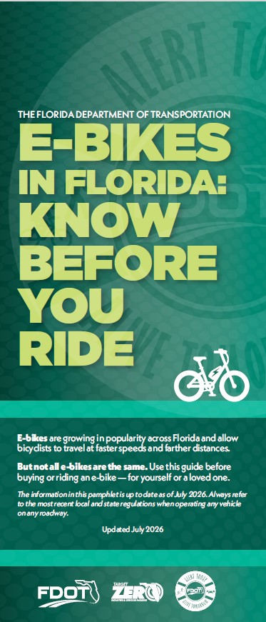


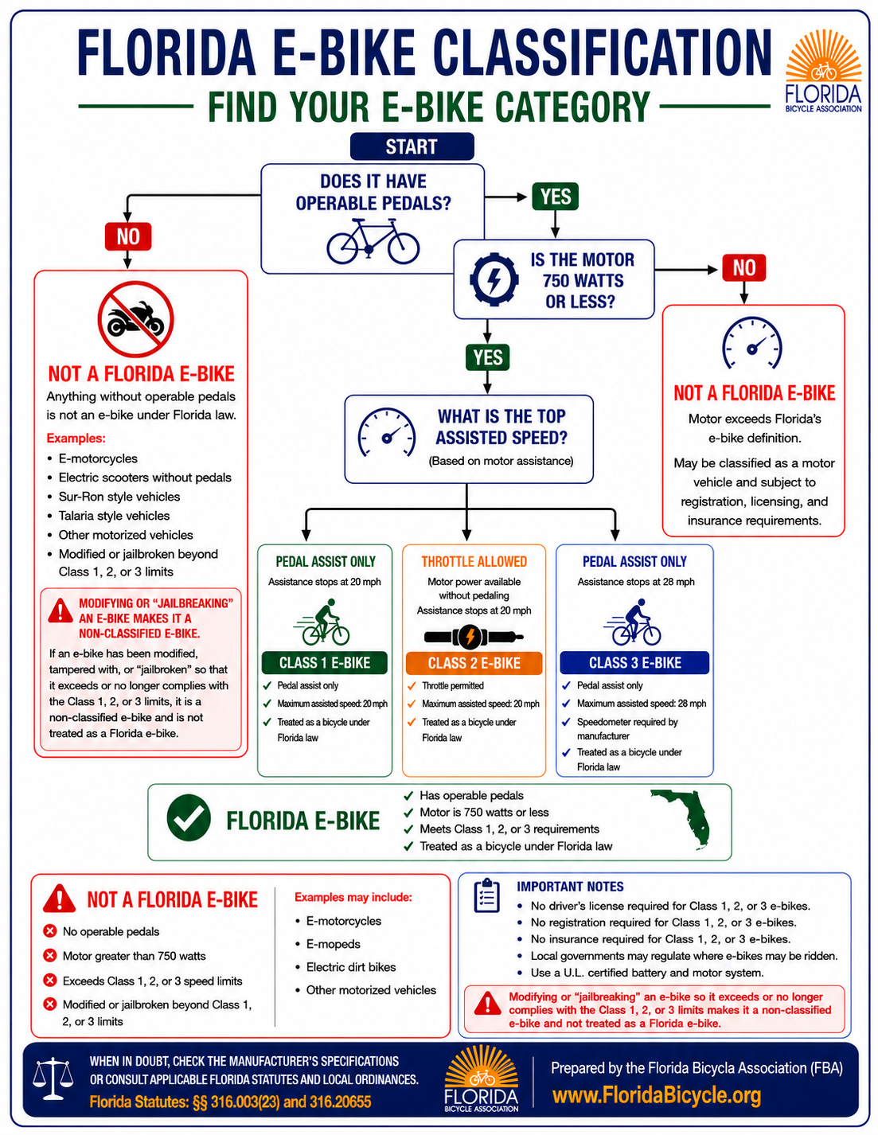
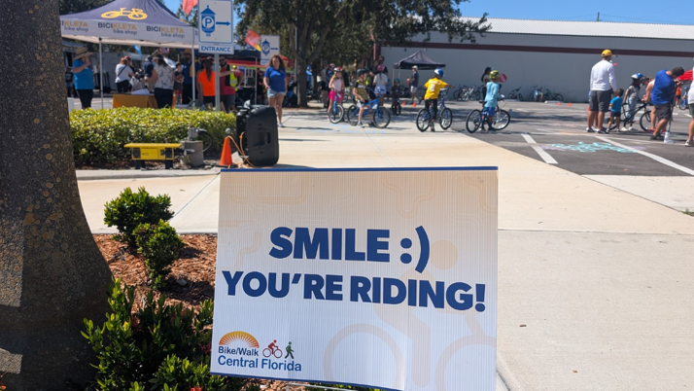
Public Education: Community
Bike/Walk Central Florida and Children’s Safety Village:
  BWCF Best Foot Forward Program: 6 events, 997 people reached, 1049 materials distributed.
  BWCF SAFE T: 15 events, 3,000 children educated, 1,200 helmets fitted (this total is combined (activities in OC across all funding partners)
  CSV:1,923 children educated
Florida Bicycle Association and American Bicycle Education Association (ABEA):
  -Provide rider education, safety resources, helmet/safety-equipment guidance, and advocacy for safer biking and e-bike use.
  -ABEA e-bike training for teens on e-devices and course specifically tailored to teen riders
FDOT: Developed an E-Bike Safety School Campaign Toolkit for middle and high schools including brochures, posters, presentations and social-media materials for students and families.
80%
Notes:
This summer, Operation Best Foot Forward brought law enforcement agencies together across 10 Florida counties for a multi-week enforcement campaign focused on improving driver compliance with Florida’s crosswalk law. During the operation, law enforcement conducted 41 enforcement details and 516 traffic stops, issuing warnings and citations to drivers who failed to yield to pedestrians in crosswalks.

Slide 13
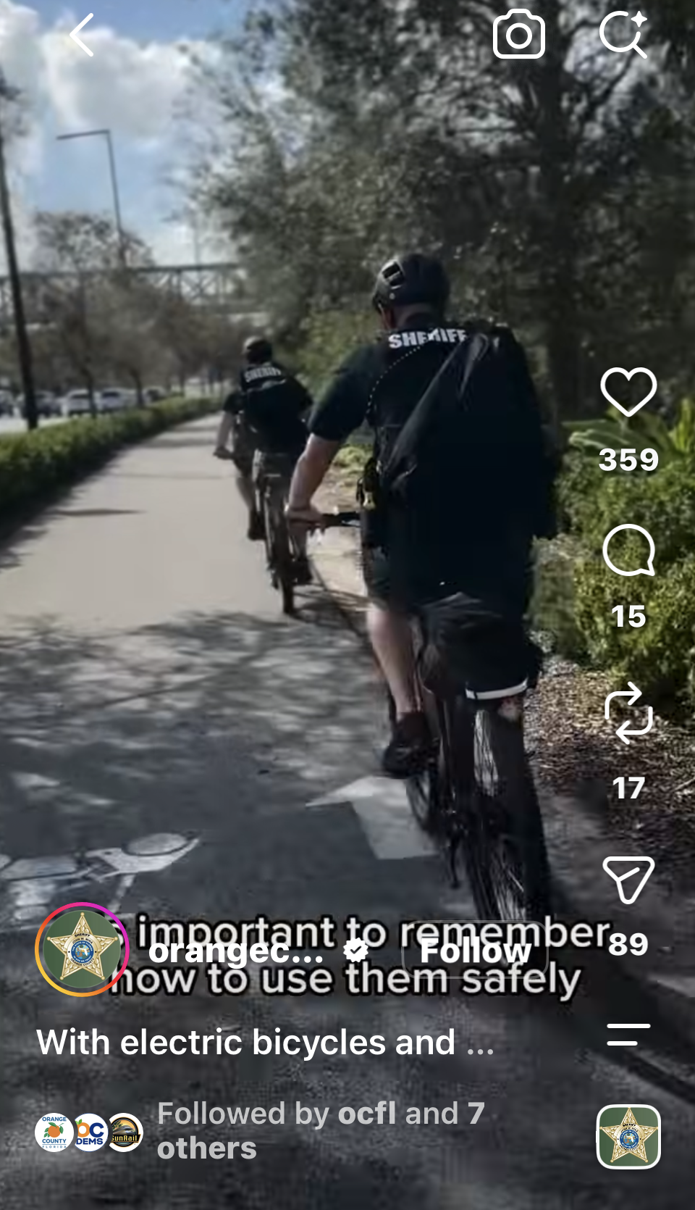
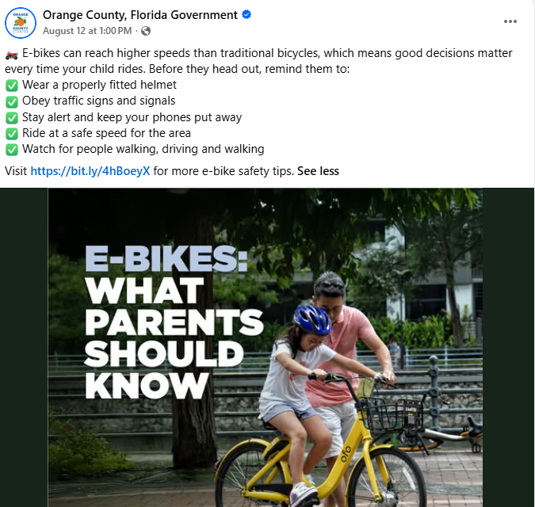
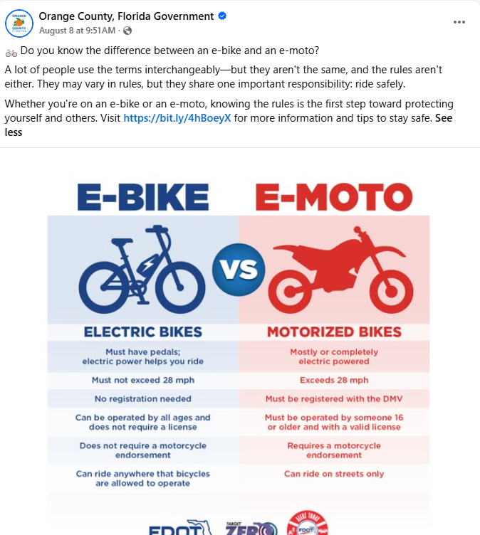
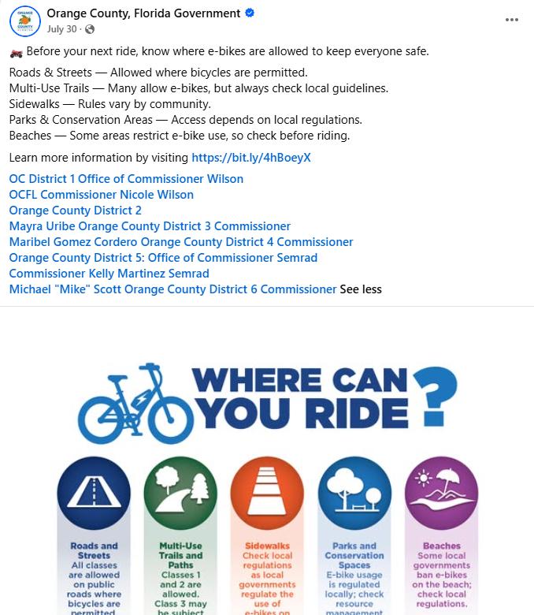
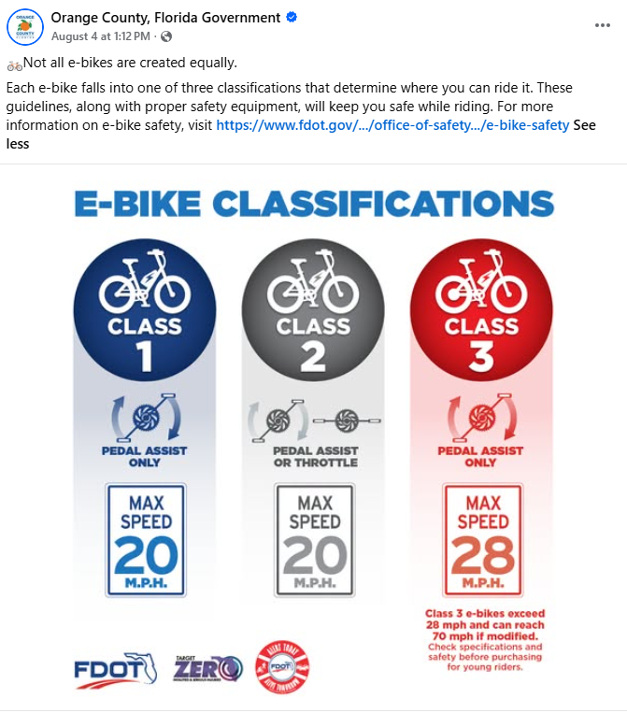
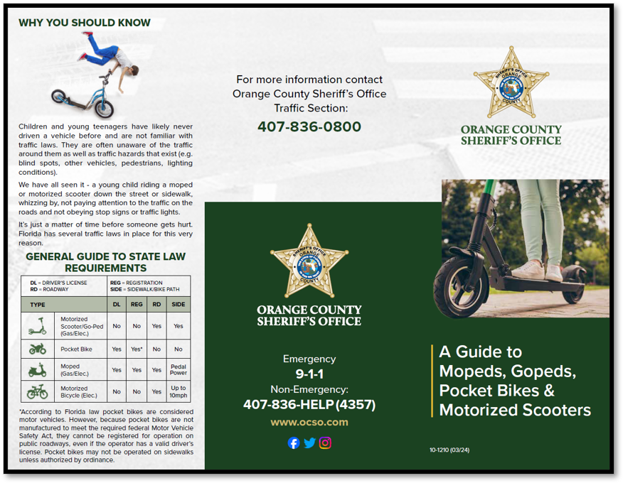

Public Education: Social Media
Lack of Data
Lack of education for device users both children & adults
Helmet requirements
Yielding requirements
Nighttime/Predawn visibility requirements
Inconsistency or lack of laws/ordinances
Trail etiquette
Impaired/ Distracted Operation
The objective is to make micromobility safer while maintaining the mobility benefits these devices provide
Notes:
Orange County’s approach must be broader than simply developing a new ordinance. The effort is really about improving safety across the entire micromobility system.
That means looking at the data, understanding where crashes and injuries are occurring, and identifying the behaviors and infrastructure conditions contributing to those incidents. We have been doing this through the county commitment to vison zero.
It also means bringing together education, enforcement, engineering and policy rather than relying on any one solution.
This fits within the County’s broader Vision Zero and Safe Systems approach, which recognizes that transportation safety requires multiple layers of protection—not just asking people to behave differently.
And importantly, the County already has transportation safety programs investing in sidewalks, bicycle facilities, speed management, crossings and other safety improvements.
The objective is to make micromobility safer while maintaining the mobility benefits these devices provide.”
Specific Information:
Orange County posted about micromobility 7 times on Facebook
Impressions: More than 37K
Engagement Rate: 4.5%
Total Engagements: 1,714
Top Posts:
E-moto: Post: 944 Engagements
E-bike Classes Post: 490
What Parents Should Know: 167

Slide 14


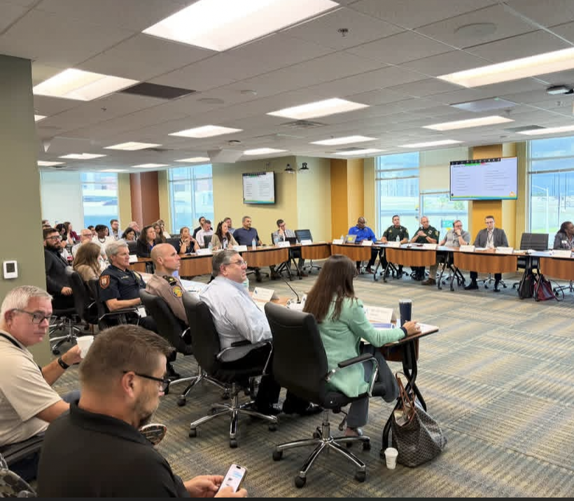
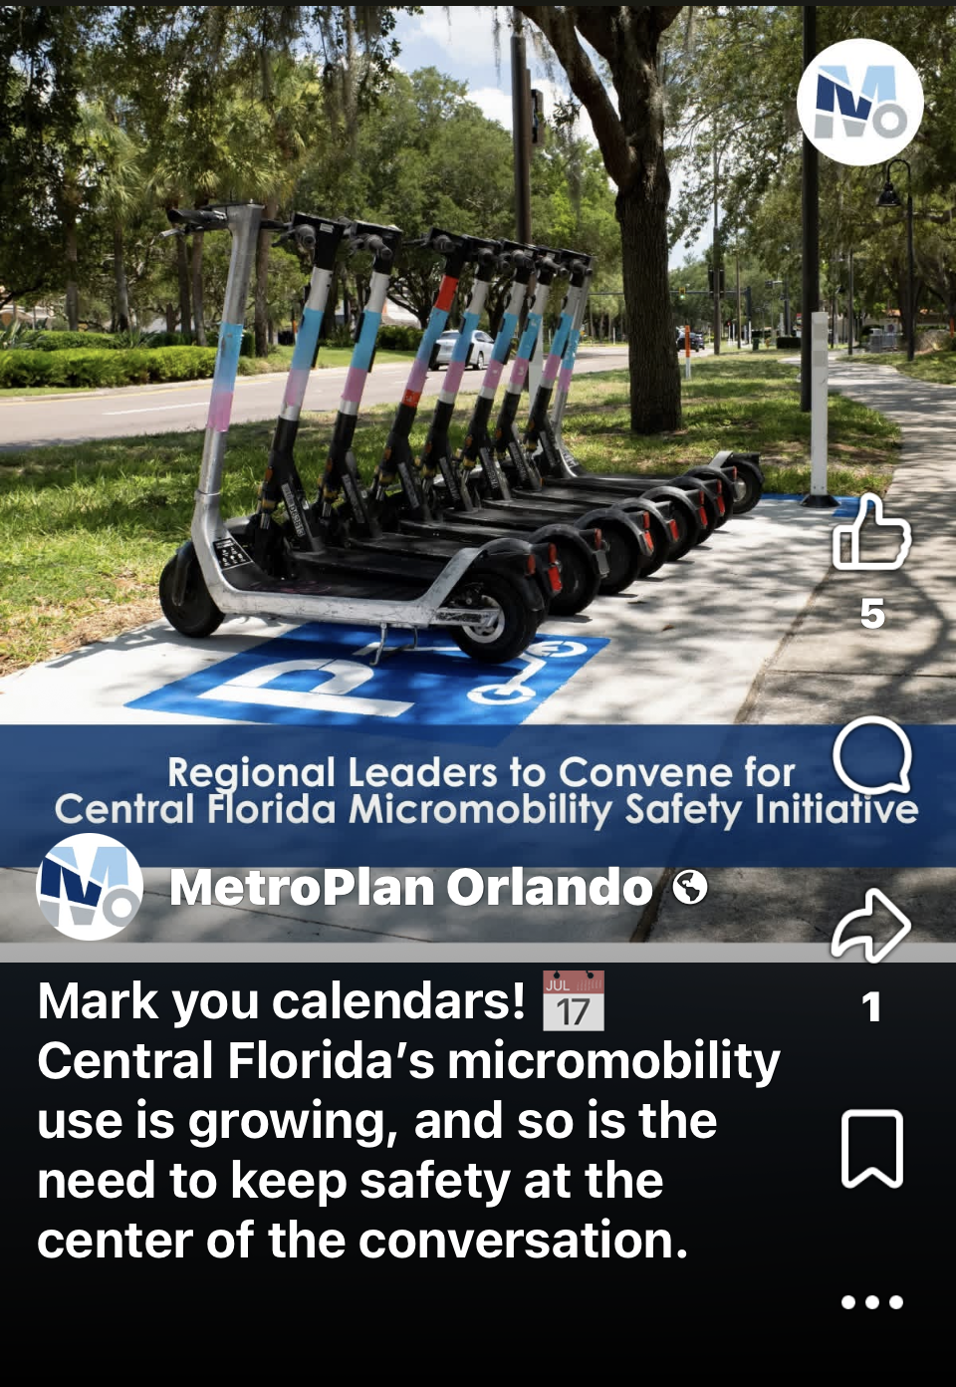
Public Education: Moving Forward
First regional meeting: 80+ participants from 20 organizations in CFL
Orange, Osceola, Seminole & FDOT working together
Focus areas:
  -Education
  -Enforcement
  -Infrastructure
  -Data
  -Policy
Regional workgroups will develop next steps to explore
2027 legislative priorities
There is a need for a regional consensus on Micromobility regulations
Key takeaway: Micromobility safety is increasingly being approached as a regional issue—not something that stops at city or county lines.
Notes:
From a Planning Perspective-Orange County participated in the first regional roundtable focused specifically on micromobility safety in Central Florida. More than 80 people participated, representing 20 organizations across government, law enforcement, education, transportation, and health and safety.
The important point is that Orange, Osceola and Seminole are beginning to approach this as a regional issue. The discussion centered on five common areas: education, enforcement, infrastructure, data, and policy.
This is not a finished regional policy yet. The roundtable was the starting point for identifying common challenges, sharing what is working, and potentially creating focused workgroups.
MetroPlan Orlando plans to use this process to identify near-term policy considerations ahead of the 2027 legislative session.
80+ participants representing 20 organizations from local government, law enforcement, education, transportation, health and safety participated in the inaugural regional roundtable.
Orange, Osceola and Seminole counties (and schools) are working together to address micromobility safety across jurisdictional boundaries—including e-bikes, e-scooters and other devices.
Stakeholders identified five common areas for regional coordination: education, enforcement, infrastructure, data and policy.
The initiative will move into an ongoing regional process, with focused workgroups to be established where appropriate and near-term policy considerations identified ahead of the 2027 Florida legislative session.
Key takeaway: Micromobility safety is increasingly being approached as a regional issue—not something that stops at city or county lines.

Slide 15
Presentation Outline
Background and Overview
Public Awareness and Concerns
Public Education
Micromobility Legislation
Proposed Ordinance
Summary
Board Direction

Slide 16
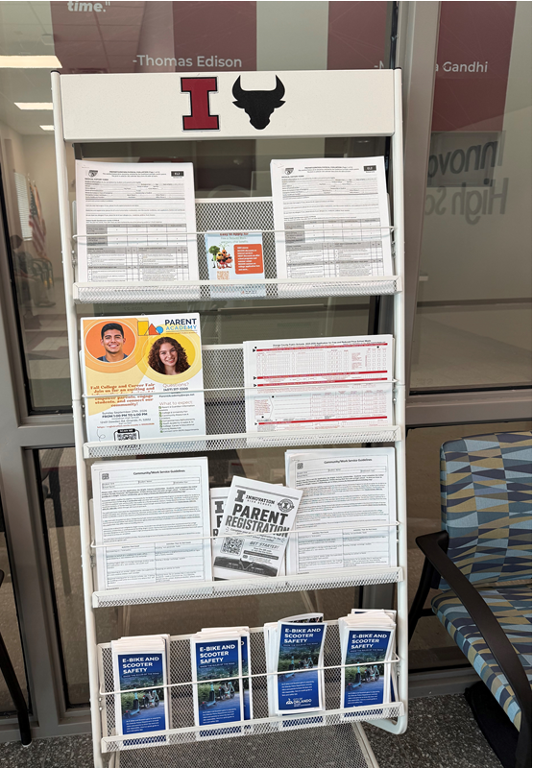
Micromobility Legislation: Federal
Federal Role in Micromobility
  Safety and manufacturing standards; use on public land management; some funding for micromobility projects
  E-Device Class System: Developed by states (California, 2015) and Industry, widely adopted nationally
  E-bikes: Defines e-bikes as consumer products under 15 U.S.C. § 2085 (≤750W, 20 mph) (2002)
  E-scooters: No unified federal definition—treated as consumer devices
  E-devices: No registration, titling and insurance required for e-bikes and e-scooters
  Operations (where/how to ride): Left to state and local jurisdictions to administer
Notes:
Narrative-
Federal law defines low-speed e-bikes (≤750W, ≤20 mph) IF12459.4.pdf
States/Industry develops 3-class system (speed + throttle)
Federal agencies adopt as policy for land management
States (including Florida) later codify into law
Local governments regulate use (paths, sidewalks, enforcement)
Adoption into Florida State Law
Florida formally adopted the three-class system into statute.
A. Florida Statute: Definition of Electric Bicycle
Florida Statutes §316.003(4) defines “electric bicycle”
Mirrors federal + model law:
≤750 watts
Includes Class 1, 2, 3 structure
B. Florida Class Definitions (Codified)
Florida law explicitly incorporates:
Class 1: pedal assist, 20 mph
Class 2: throttle, 20 mph
Class 3: pedal assist, 28 mph
C. Operational Rules in Florida
Treated as bicycles (generally)
Class 3:
Helmet required if under 16
Restricted from some shared-use paths
Federal government DOES NOT:
Set riding rules for streets/sidewalks
Regulate e-scooter use directly
👉 Those are controlled by state + local laws
Federal law does NOT ban states or cities from requiring:
Registration
Licensing
Insurance
BUT:
If a state regulates e-bikes/e-scooters in a way that conflicts with the federal definition (e.g., treating them like motor vehicles), it can raise preemption issues under federal law

Slide 17
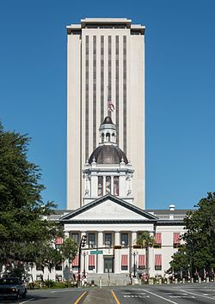
Micromobility Legislation: State
State of Florida Role in Micromobility
  E-Scooter/Micromobility Devices § 316.2128 (2019)
    Riders of a fleet owned E-scooters/micromobility devices have same rights and duties as bicycle riders.
    No driver license, registration or insurance required
    Local law enforcement can regulate operations based on
    state law
  Bicycles & E-Bikes § 316.20655 (2020)
    E-bikes treated as bicycles, may operate wherever bicycles are allowed
    No license, registration or insurance required
    Local law enforcement can regulate operations based on state law
    E-Device 3-class system
Notes:
E-bikes are treated the same as bicycles (rights + duties).
No driver license, registration, or insurance required.
Local governments can regulate where they operate (paths, sidewalks, etc.).
Defines Class 1, 2, and 3 e-bikes (speed/pedal assist distinctions). (from statute context)
Florida law explicitly incorporates:
Class 1: pedal assist, 20 mph
Class 2: throttle, 20 mph
Class 3: pedal assist, 28 mph
Helmet required if under 16
Can be restricted on certain facilities (trails, beaches, etc.).
E-Scooter/Micromobility Devices § 316.2128 (Adopted 2019) _h0971er.docx
E-scooters/micromobility devices have same rights and duties as bicycles.
No driver license required.
No registration or insurance required.
Local governments can regulate operations (roads, sidewalks, etc.).
Shared device companies must secure devices during storms.
Electric Bicycles § 316.20655 (Adopted 2020)
Florida Statutes § 316.20655 (2025) - Electric Bicycle Regulations. :: 2025 Florida Statutes :: U.S. Codes and Statutes :: U.S. Law :: Justia

Slide 18
Micromobility Legislation: State
State of Florida broadens definition of Micromobility Devices under § 316.003 (2025)
Component | 2024 Definition | 2025 Definition
Basic concept | Shared/rental device | Individual transportation device
Ownership | Essentially shared/rental | Private OR shared
App reservation required | Yes | No
Width | Not specified | 20–36 inches
Weight | Not specified | 50 lbs. or less
Typical speed | Not specified | Typically, <15 mph
Maximum speed | 20 mph | 28 mph
E-bikes included | Not defined | Yes
Motorized scooters | Yes | Yes
Notes:
“Florida significantly broadened the statutory definition of micromobility devices in 2025—from primarily app-based/shared devices capped at 20 mph to a broader category encompassing privately owned and shared devices, including bicycles, e-bikes and motorized scooters, generally up to 28 mph.”
(41) MICROMOBILITY DEVICE.—A motorized transportation device designed for individual use which is typically 20 to 36 inches in width and 50 pounds or less in weight and which operates at a speed of typically less than 15 miles per hour but no more than 28 miles per hour. This term includes both a human-powered and a nonhuman-powered device such as a bicycle, electric bicycle, motorized scooter, or any other device that is owned by an individual or part of a shared fleet Any motorized transportation device made available for private use by reservation through an online application, website, or software for point-to-point trips and which is not capable of traveling at a speed greater than 20 miles per hour on level ground. This term includes motorized scooters and bicycles as defined in this chapter.

Slide 19
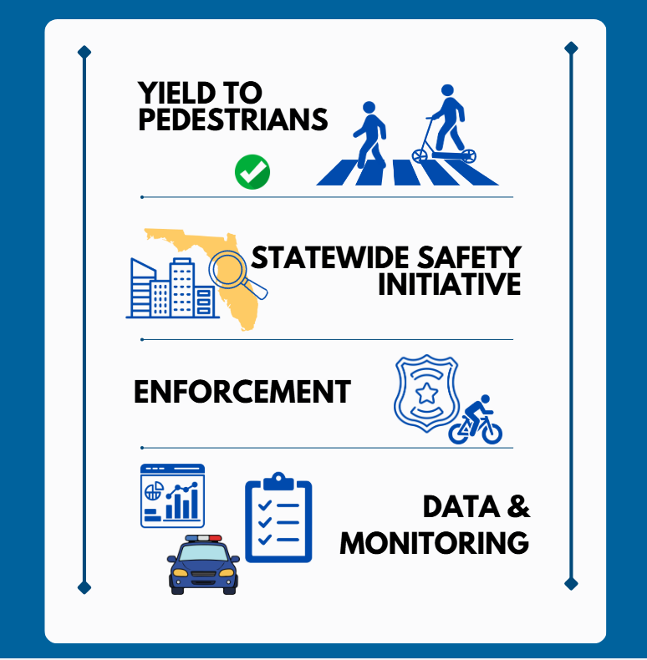
Micromobility Legislation: SB 382 (2026) Vetoed
Required e-bike riders to yield to pedestrians on shared-use paths.
Required an audible warning when passing pedestrians.
Limited e-bike speeds to 10 mph within 50 feet of pedestrians on sidewalks and shared-use paths.
Established a Micromobility Safety Task Force to recommend statewide safety improvements.
Required statewide micromobility crash data collection and reporting.
Violations constituted a non-moving violation with a fine of $30-63 (base penalty and fees under §318.18 )
Vetoed by Governor DeSantis on June 25, 2026; provisions did not become law.
VETO
Notes:
Bill passed unanimously in the FL Senate and House.
CS/SB 382 received unanimous bipartisan support in the Florida Legislature, passing the Senate 37–0 and the House 112–0, demonstrating broad agreement that additional micromobility safety measures were needed.
Despite that support, Governor Ron DeSantis vetoed the bill on June 25, 2026.
In his veto message, he stated that the bill represented "a little bit of an overreach" and expressed concern that the crash reporting requirements could result in increased surveillance and policing of e-bike riders by local governments and law enforcement.
As a result, none of the bill's provisions took effect, leaving regulation of many micromobility safety issues to existing state law and local governments.

Slide 20
Micromobility Legislation: Other Local Gov’ts
Jurisdiction | Local E-bike Ordinance | Speed Limits | Notable Provisions
Oviedo | Currently: Relies on current state laws Proposed Ordinance | 10 MPH on sidewalks and shared-use paths | Reckless operation leads to a UTC fine of $116; If under age 14, parents can be cited Proposed: 10 MPH on sidewalks/shared use paths. Pedestrians would have priority. Helmets required for under age 16. Escalating penalties $50-250
Orlando | Yes (2021) Chapter 10; Ord. 2021-79 Considering new Ordinance |  | Currently has regulated shared micromobility program, parking, operating zones Proposed ordinance language not yet available
Ocoee | Yes (2026) Chapter 153, Art. V | 10 MPH on sidewalks and shared-use paths | Speed limits, yielding, lighting, reckless operation, local fine of $164
Winter Garden | Yes (2026) Ord. 26-05 | 10 MPH on sidewalks and shared-use paths | Age limit 15, speed limits, yielding, ID, Speed limits, local fine of $100 as civil penalty for violations; UTC for state law violations; parents/guardians can be responsible for minors' penalties
Winter Park | Yes (2021): Ord. 3195-21 Ord. 3376-26 Second reading 9/23/26: Approved |  | E-device rentals are prohibited. Trails and Parks rules. City approved safety course completion required to operate for those under age 16. Sidewalk restriction in Central Business District, Hannibal Square District, Orange Avenue District. Parked devices may not obstruct the ROW. Possible impoundment. Election of completion of safety course for 1st violation with fines ranging from $25-45. Parents responsible for fines of minors.
Daytona Beach | Yes (2026) |  | Class I,II on roadways & sidewalks,5 MPH speed near schools, crosswalks & intersections, yielding, Minimum age: 11 on roadways & sidewalks, ID, No modifying, racing, reckless riding, towing or unsafe passenger; Civil fines: $100, $200 Impound fee
Notes:
Bolded print for Winter Park:
The City of Winter Park approved a Micromobility ordinance on 9/23. Staff has updated the slide to reflect this.
Notably, riders under 16 must complete a city approved e-device safety course prior to operating an e-device within permissible city limits.
The City of Winter Park has chosen to restrict e-device use in certain districts.
Violation fines can be waived with the election of a safety course for a first offense.
At this time, the City of Winter Park has not selected any e-device safety courses and staff anticipate this occurring in the months ahead, which will require their city commission to pass an additional resolution.

Slide 21
Micromobility Legislation: Other Local Gov’ts
Jurisdiction | Local E-bike Ordinance | Speed Limits | Notable Provisions
Cocoa Beach | Yes (2021) Ord. 1700 | 10 MPH in specified pedestrian/sidewalk areas under current rules | Prohibits micromobility devices in specified areas; regulates bicycles/e-bikes/scooters; parking/obstruction rules; restrictions in CBD, Hannibal Square and Orange Avenue areas
Deltona | Yes (2026) Ord. 02-2026 – Chapter 66 |  | Significant e-bike/e-scooter restrictions; under-18 restrictions on sidewalks, bike paths & public roadways, rescinded by City Council. City will revisit.
Oceola County | Yes (2020) Ord. 2020-70 | Ordinance uses 20 MPH for its motorized-scooter definition | Micromobility Ordinance applies to shared-fleets. Engineering study; BCC approval; 51% community support; designated operating areas; signage; enforcement up to $500/violation or $500/day; removal/impoundment authority
Lake County | N/A |  | Bicycle/trail provisions exist, but no comprehensive countywide micromobility framework identified. Current code is codified through Ordinance 2026-3, adopted Jan. 20, 2026.
Brevard County | N/A |  | County has bicycle/trail and other transportation regulations, but no comparable comprehensive countywide micromobility ordinance identified. Current code is codified through Ordinance 25-19, adopted Oct. 2, 2025.
Seminole County | N/A |  | Bicycle/trail regulations and planning provisions address micromobility, but no dedicated comprehensive countywide ordinance identified. Current code is codified through Ordinance 2025-25, adopted Nov. 18, 2025
Notes:
For counties that do not have local comprehensive Micromobility Ordinances, they are relying on State Law provisions.

Slide 22

Micromobility Legislation: Orange County
Orange County’s role in Micromobility
  E-Bike Ordinance 2021-31 (2021)
    E-bikes defined; classes 1, 2, 3 permitted, devices treated as bikes
    E-bikes permitted on bike paths, shared use paths, bike lanes, streets, highways, roadways, and shoulders
    Class 3 bikes not permitted on shared paths or county trails
    E-bike users must yield to pedestrians on sidewalks and in crosswalks giving an audible signal to pedestrians before passing
  Micromobility Devices Ordinance 2022-07 (2022)
    Applies only to shared use devices, no regulation of private devices
    E-scooters treated as bikes with same rights and responsibilities
    Devices may not block sidewalks
    Provisions for shared e-devices (up to three companies permitted)
Notes:
From Joy in Attorney's Office: Note that Ordinance are oriented for SHARED devices, not personal ones. There is little regulation for personal devices in OC.

Slide 23
Presentation Outline
Background and Overview
Public Awareness and Concerns
Public Education
Micromobility Legislation
Proposed Ordinance
Summary
Board Direction

Slide 24
Proposed Ordinance: Applicable State Law
Governing Law - Chapter 316, Florida Statutes (State Uniform Traffic Control)
  Establishes uniform traffic laws throughout the state
  Allows local governments to enact laws only as specifically authorized
Local governments are authorized to:
  Regulate the operations of micromobility devices on sidewalks, streets, highways, bicycle paths, multiuse paths, trail networks
  Set a maximum speed of 15 mph on sidewalks
  Set minimum age requirements
  Require possession of photographic government issued identification
  Provide training on safe operation and compliance with micromobility traffic laws

Slide 25
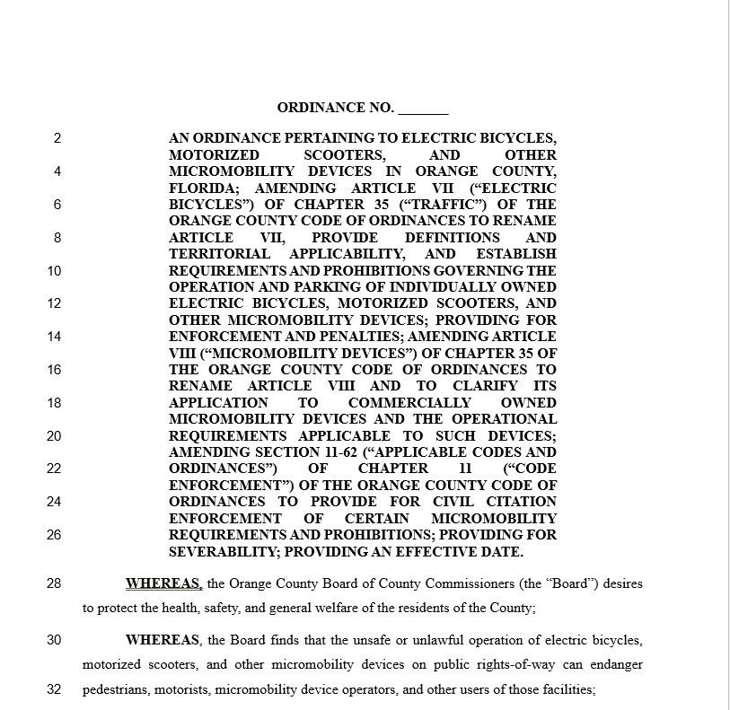

Proposed Ordinance: Overview
Addresses regulatory gaps in State statutes.
Applies to operators of individually owned and shared fleet devices
Authorizes enforcement by the Sheriff’s Office throughout Orange County, and within municipal boundaries.
Authorizes enforcement by municipal law enforcement officers within their municipal boundaries.
Notes:
This Collaborative effort is intended primarily to increase safety for all transportation network users. The Proposed Draft Ordinance was advertised for this public hearing on Sept. 13.
What the ordinance does
Creates one County framework for individually owned micromobility devices, including e-bikes, motorized scooters and similar devices.
Keeps Florida's three e-bike classes:
Class 1 — pedal assist, up to 20 mph
Class 2 — throttle, up to 20 mph
Class 3 — pedal assist, up to 28 mph.

Slide 26
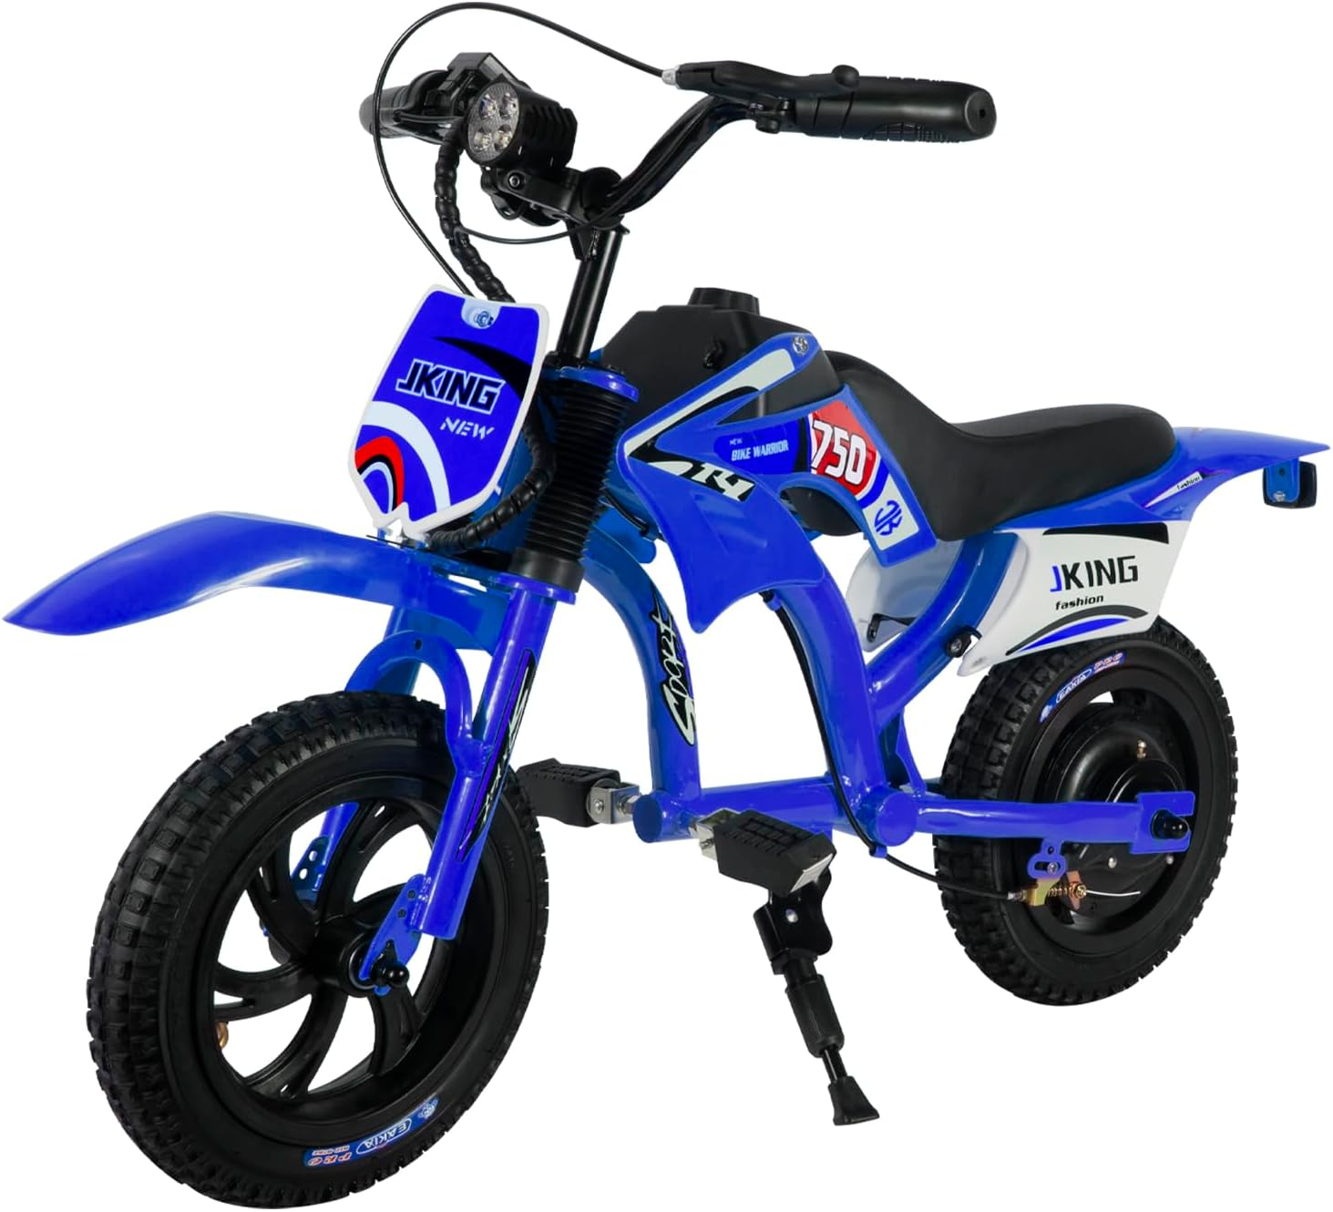
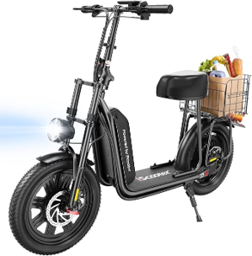
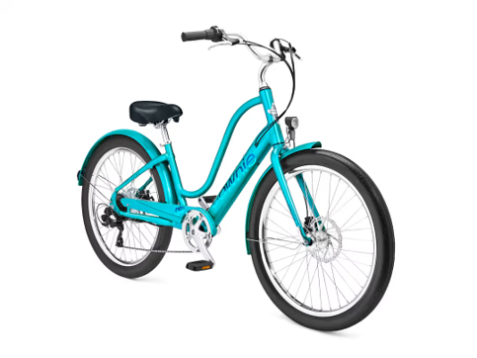
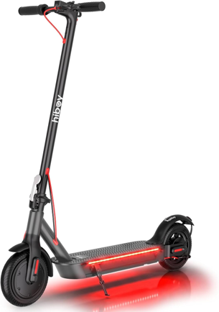
Proposed Ordinance: Amends Sec. 35-90
Defines the term “micromobility device”:
  Designed for individual use
  Motorized transportation device
  Weight – 50 lbs or less
  Speed – No more than 28 mph

Slide 27
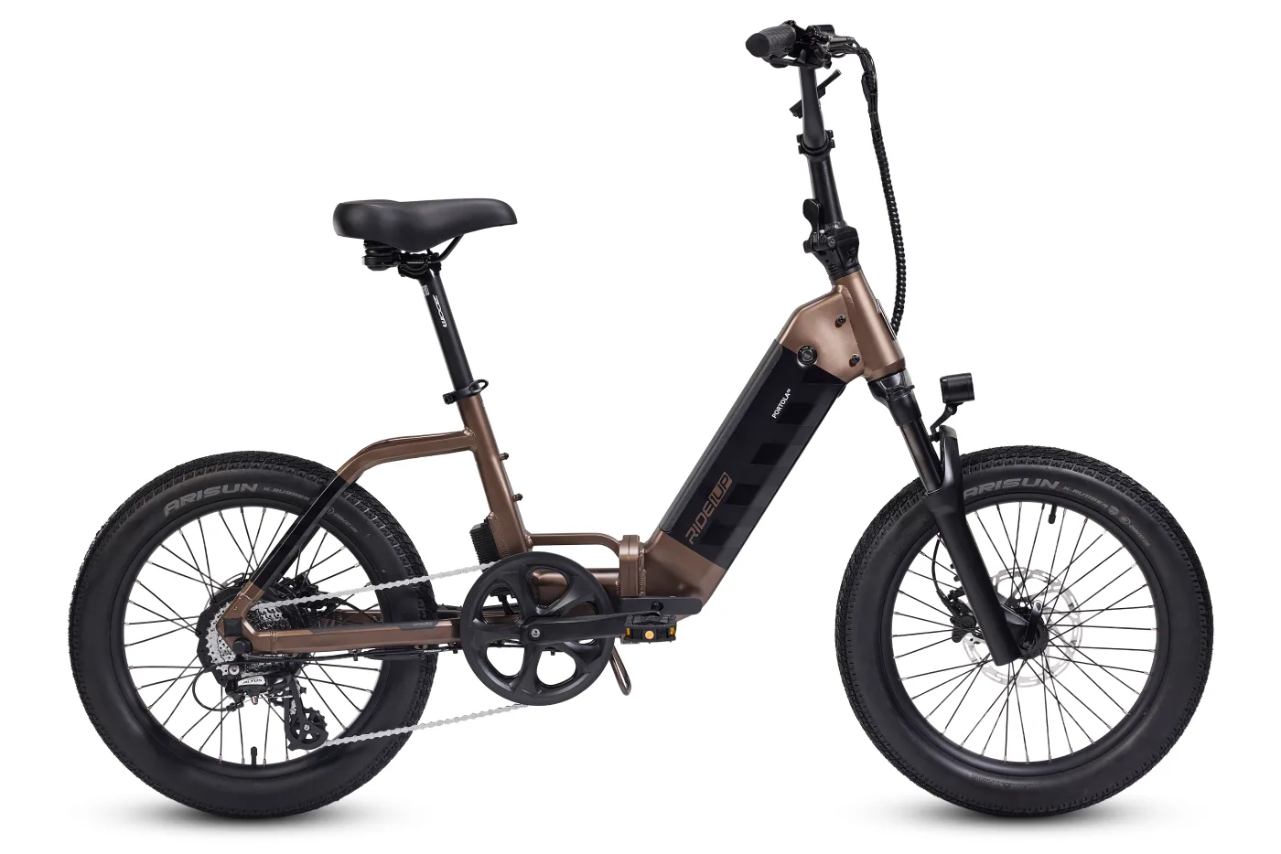
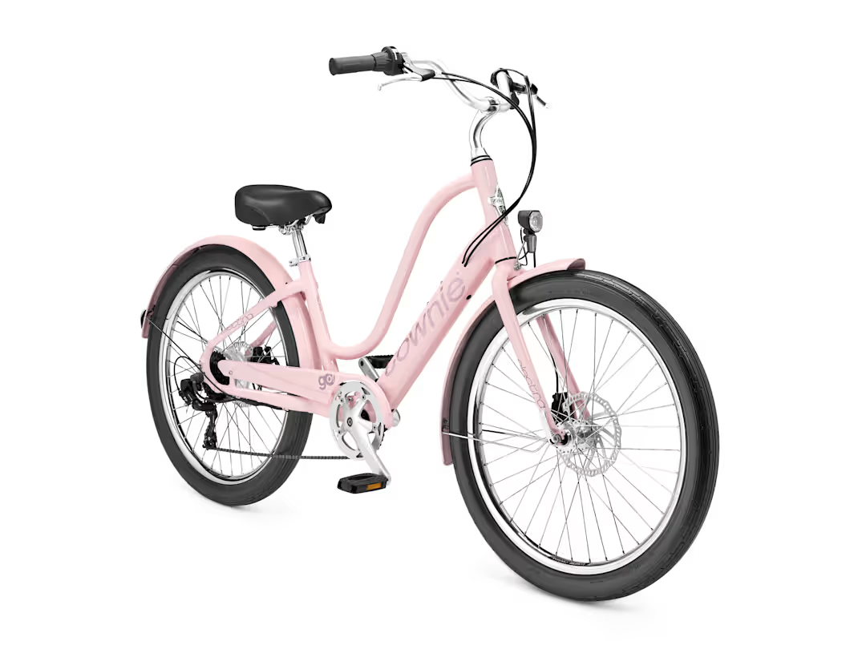
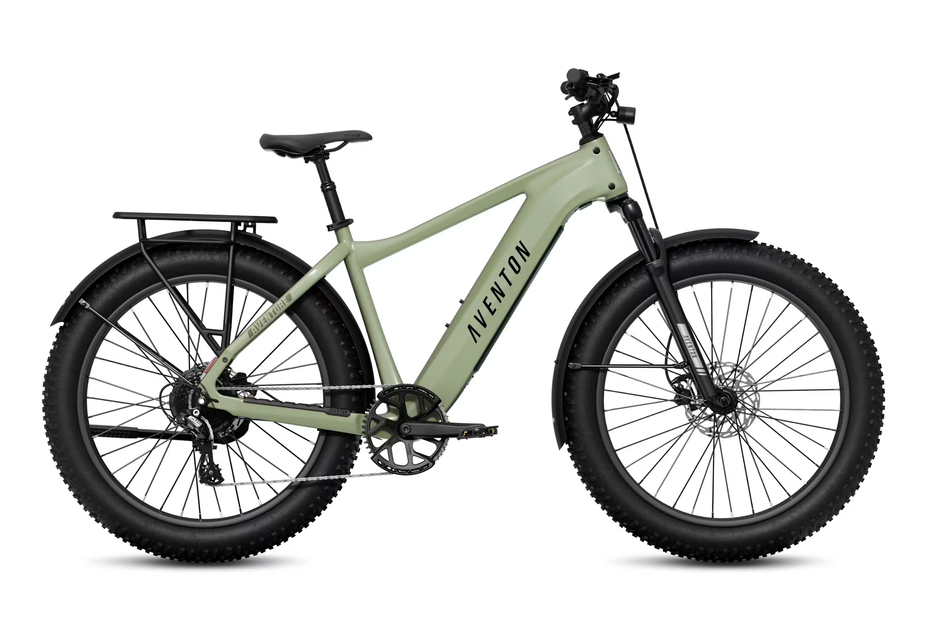
Proposed Ordinance: Amends Sec. 35-90
Defines the term “electric bicycle” (“e-bike”):
  Motorized bicycle or tricycle
  Fully operable pedals
  Electric motor less than 750 watts
  Speed – No more than 28 mph

Slide 28
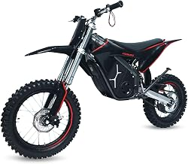
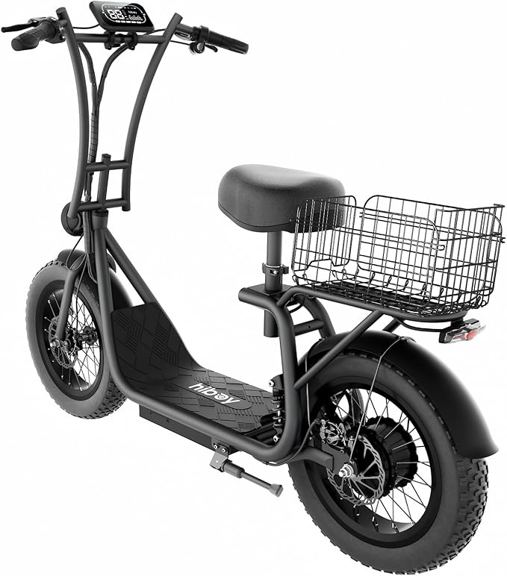
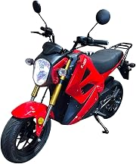
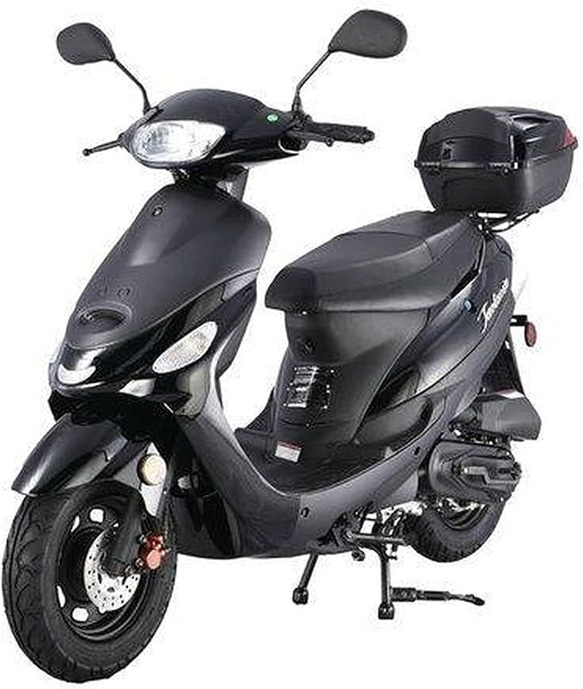
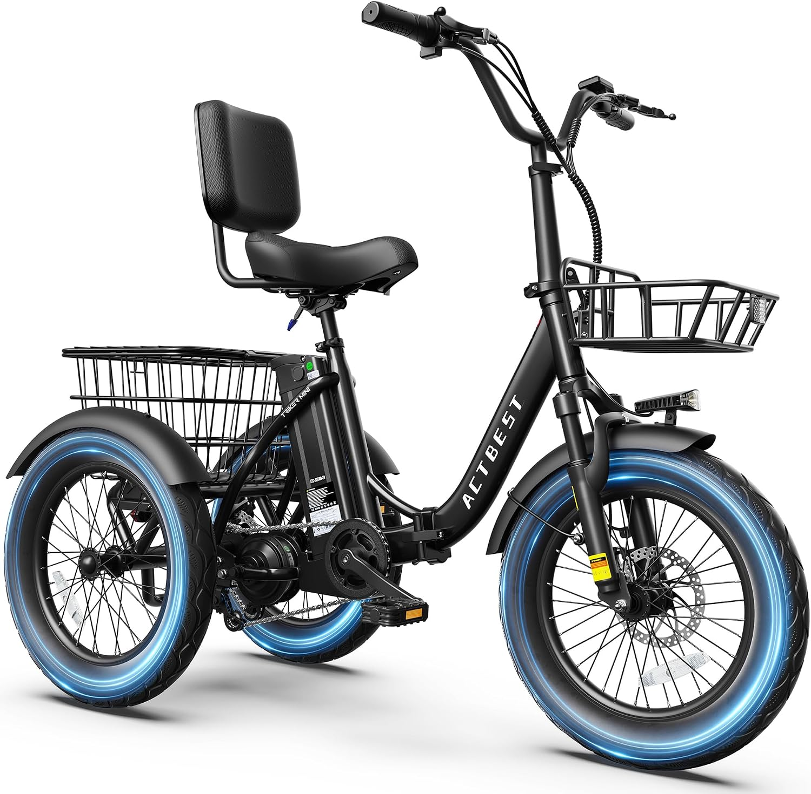
Proposed Ordinance: Amends Sec. 35-90
Defines the term “electric motorcycle” (“e-moto”)
  No fully operable pedals
  Powered by an electric motor that exceeds 750 watts
  Capable of exceeding a speed of 28 mph

Slide 29
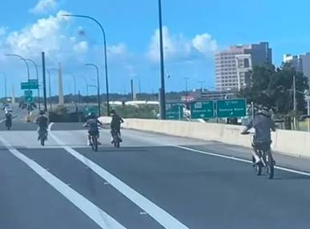
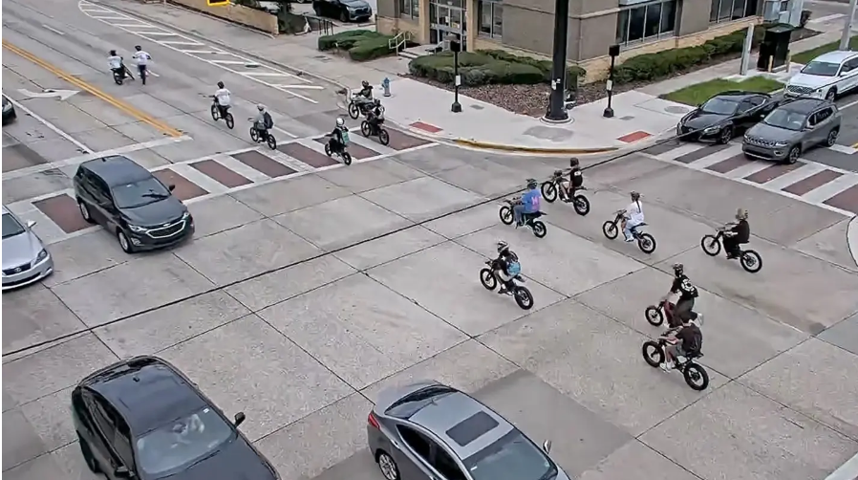
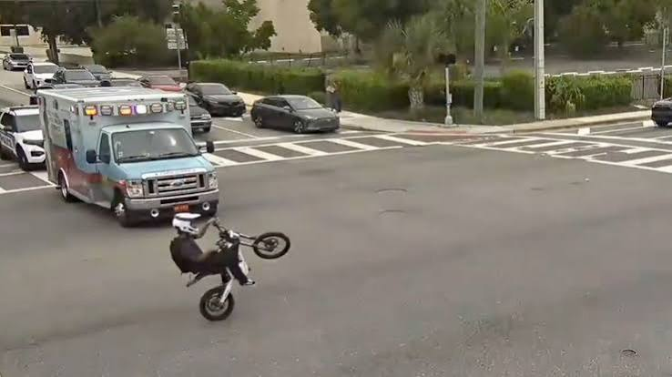
Proposed Ordinance: Amends Sec. 35-90
Defines “careless or reckless operation”
  Without appropriate care or prudence
  Endangers persons or property
  Interferes with safe travel of other vehicles or persons
Street Takeover
Wheelie
Notes:
Image Sources: Fox 35 Orlando

Slide 30
Proposed Ordinance: Creates Sec. 35-90.1 & Amends Sec. 35-91
Creates Sec. 35-90.1
  Applies countywide
    Enforceable in unincorporated areas
    Enforceable within municipalities, except in municipalities that have adopted a micromobility ordinance
Amends Sec. 35-91
  Restates state regulations:
    Requirements for lights, reflectors, brakes, and other equipment
    Prohibitions against parents/guardians from knowingly permitting minors to commit violations
    Requirements for yielding to pedestrians
    Prohibitions against tampering/modifying e-bike speed capabilities or motor disengagement
Notes:
This Collaborative effort is intended primarily to increase safety for all transportation network users. The Proposed Draft Ordinance was advertised for this public hearing on Sept. 13.
What the ordinance does
Creates one County framework for individually owned micromobility devices, including e-bikes, motorized scooters and similar devices.
Keeps Florida's three e-bike classes:
Class 1 — pedal assist, up to 20 mph
Class 2 — throttle, up to 20 mph
Class 3 — pedal assist, up to 28 mph.

Slide 31
Proposed Ordinance: Amends Sec. 35-91
New County requirements and prohibitions:
  Speed limits
    10 mph -- sidewalks and shared-use paths
    28 mph -- roadways, shoulders & bicycle facilities
  Parking requirements
    must park upright
    cannot obstruct pedestrian or vehicular movements
    parking on public property allowed only in designated areas
  Prohibited actions
    street takeovers
    stunt driving
    towing/pulling of other devices
    e-motos on sidewalks, shared-use paths, shoulders, bike lanes, bicycle paths, trails (e-motos only allowed on roadways in compliance with applicable State motor-vehicle licensing, registration, and other requirements)
    abandonment of devices on public property
    gas-powered devices on marked recreational trails
Notes:
What the ordinance does
Creates one County framework for individually owned micromobility devices, including e-bikes, motorized scooters and similar devices.
Keeps Florida's three e-bike classes:
Class 1 — pedal assist, up to 20 mph
Class 2 — throttle, up to 20 mph
Class 3 — pedal assist, up to 28 mph.
Separates e-motos/electric motorcycles from legal micromobility devices. Devices over 750 watts, without fully operable pedals, and capable of exceeding 28 mph are treated as electric motorcycles and must comply with State motor-vehicle licensing/registration requirements.
Applies County rules in both incorporated and unincorporated Orange County, unless a municipality has its own ordinance covering the same subject. In that case, the municipal ordinance controls.
Allows Class 1 and 2 e-bikes on shared-use paths, unless posted otherwise.
Prohibits Class 3 e-bikes from shared-use paths.
Allows all e-bike classes on sidewalks, but establishes a 10-mph maximum.
Establishes a general 10-mph limit on sidewalks and shared-use paths unless a lower limit or prohibition is trails up to 28 mph or as posted.
Allows micromobility devices on County roadways, shoulders, bike lanes, bike paths and, unless a lower restriction is posted. Gas-powered micromobility devices are prohibited on marked recreational trails.
Creates parking rules intended to keep sidewalks, ADA routes, curb ramps, crosswalks, transit stops, fire hydrants, entrances and emergency access clear.
Prohibits street takeovers and stunt riding, including wheelies, jumps and tricks that endanger people or property.
Prohibits towing/pulling another person, vehicle or device.
Prohibits riding where signs, barricades or traffic-control devices prohibit micromobility operation.
Prohibits e-motos on sidewalks, trails, bike paths, bike lanes, shoulders and similar facilities. They can use roadways only if they comply with State motor-vehicle requirements.
Creates an abandonment provision: a device left in the same place on public property for a week or more can potentially be treated as abandoned/lost under Chapter 705, Florida Statutes.

Slide 32
Proposed Ordinance: Amends Section 35-93
Micromobility Proposed Ordinance: Enforcement
Violation Examples | Enforcement | Penalty Mechanism
Helmet under age 16 Lights after dark Audible signal when passing pedestrians | Current State Law | Verbal Warning and Safety Brochure or Uniform Traffic Citation (UTC) -Fine: $63-304+
Speed greater than 10 MPH on Sidewalk or shared-use path Careless or reckless riding Parking micromobility device so as to obstruct ROW | Proposed County Ordinance | Age 18 or older: -Warning or County Citation -Fine: $100 -Possible impoundment of device Under Age 18: -First offense: -Warning/County Citation -Parent/guardian notified -Second or subsequent offense -Warning or County Citation -Fine: $100 -Possible impoundment of device
Notes:
Say: State traffic violations remain enforceable under Chapter 316; new County operational rules are noncriminal civil infractions enforceable through Chapter 162/County Code Enforcement, with potential device impoundment.
Infractions may receive an immediate county citation for a speeding (B1 Speeding), and for (B3) Street takeovers, Street takeovers, Towing, Operating where prohibited, operating an e-device on county ROWs except travel lanes ).
What would be a County infraction? (Non-criminal)
The big County-created restrictions include:
Exceeding 10 mph on a sidewalk
Exceeding 10 mph on a shared-use path
Exceeding a posted/restricted speed applicable to the device
Parking/abandoning a device in a way that obstructs pedestrian or ADA access
Parking where an official sign prohibits it
Street takeovers
Stunt driving
Towing/pulling another person or device
Operating where a County/municipal sign, barricade or traffic-control device prohibits it
Operating an e-moto in prohibited locations.
These fall under the County's §35-91(b) enforcement provision and therefore are civil—not criminal—violations.
What remains a State/UTC-type violation?
The ordinance incorporates a number of existing State requirements, including:
Yielding to pedestrians and giving an audible warning when passing
Required lighting/reflectors
Helmet requirements for persons under 16
Brakes
Riding more than two abreast where prohibited
Carrying more people than the device is designed for
Federal bicycle equipment requirements
Improper motor disengagement
Illegal modification of an e-bike's speed capability
Other applicable Chapter 316 requirements.
Fine Details per Cpt. Shaban for existing State Law: $62.50 would be any e-bike violation. Technically if we had them speeding on the road we could cite speed $129-$279 ($154-$454 in school zones). Then if there were any criminal violations with the e-moto those could be $500-$1000, or even $1104-$2604 for popping wheelies on an e-moto. The “safe” range of fines if we are dealing with true e-bikes would be $62.50 for most violations to $304 for speeding 13 over the limit in a school zone (28 MPH in a 15 MPH school zone).

Slide 33
Proposed Ordinance: Amends Article VIII
Renames Article VIII as “Commercial Micromobility Devices”
Amends Section 35-103 (“Micromobility device operational requirements.”)
  requires riders of commercially owned micromobility devices to comply with the requirements of Article VII
Notes:
Sec. 35-90 (Line 368) New section.

Slide 34
Proposed Ordinance: Amends Sec. 11-62 of Ch. 11
Violations of County micromobility requirements and prohibitions
  Subject to issuance of a County civil citation
  Classified as a Class 1 penalty: $100.00
Notes:
Effective immediately upon general law: Ordinance becomes law after filing with the State of Floridia

Slide 35
Presentation Outline
Background and Overview
Public Awareness and Concerns
Public Education
Micromobility Legislation
Proposed Ordinance
Summary
Board Direction

Slide 36
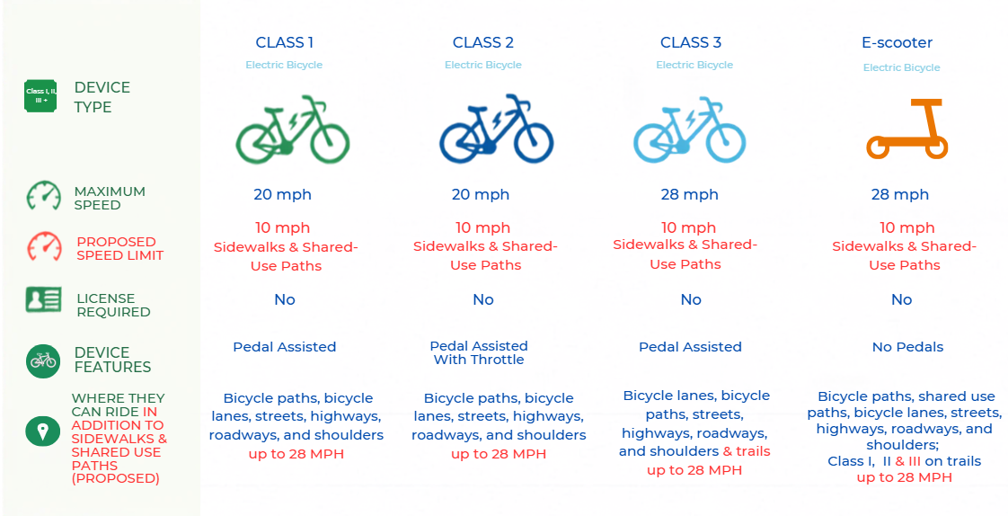
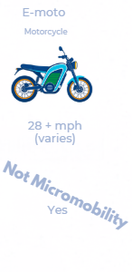

Background and Overview
Summary
Notes:
Say: “The proposed ordinance focuses on regulating the operating speed of these devices, regardless of device type or classification, rather than relying solely on the maximum speeds the devices are legally capable of reaching, as shown in the chart before you.“
The proposed changes are that there would be a 10 MPH Speed Limit on Sidewalks and Shared-Use Paths. On all other facilities types, legal e-bikes and e-scooters are limited by their device capability up to 28 miles per hour unless otherwise posted. Further, all micromobility use is subject to careless and reckless operation which means riders must choose a speed appropriate for the conditions and may not endanger other people or property nor interfere with safe travel of others.
"So in summary, the proposed ordinance focuses on regulating the operating speed of these devices, regardless of device type or classification, rather than relying solely on the maximum speeds the devices are legally capable of reaching, as shown in the chart before you.”

Slide 37
Summary
Orange County is responding to increasing micromobility use, injuries, and safety concerns.
Orange County is coordinating with regional and community partners to educate riders, motorists, pedestrians, students and parents.
Federal and Florida laws establish the basic framework for e-bikes and micromobility devices, but there is a gap that local governments are being asked to fill.
The proposed ordinance establishes a framework focused on personally owned devices, reinforcing State requirements while adding County rules for speed, parking, prohibited activities, and enforcement.
Applies countywide, unless a municipality maintains an ordinance on the same subject matter, activity, or conduct
The Sheriff’s Office has authority to enforce the County ordinance throughout Orange County, including within municipal boundaries.
Municipal officers, in municipalities where the ordinance is effective, are limited to enforcement of the ordinance within their municipal boundaries.
Notes:
Reliance on single pilot/shared program on I-Drive corridor without a plan to replicate in additional market-led areas
Why Now: Micromobility Requires County Action,
Micromobility has been around for more than 25 years; and is only increasing in popularity
Rising Safety Risks: Rapid growth in use is already contributing to increased crashes and injury trends, particularly in high-conflict areas
Limited Local Authority in Practice: Without clear county standards, agencies are left to navigate gaps in enforcement, speed control, and rider behavior
Vision Zero Commitments: Addressing micromobility is critical to meeting the County’s goal of eliminating traffic fatalities and serious injuries
Growing Mode of Transportation: Micromobility is becoming a mainstream, low-cost option—policy is needed to manage it effectively, not reactively
Sustainability & System Efficiency: Supporting safe micromobility use can reduce short car trips, congestion, and emissions—but only with the right framework in place

Slide 38
Presentation Outline
Background and Overview
Public Awareness and Concerns
Public Education
Micromobility Legislation
Proposed Ordinance
Summary
Board Direction

Slide 39
Board Direction
  APPROVE AND ADOPT AN ORDINANCE PERTAINING TO ELECTRIC BICYCLES, MOTORIZED SCOOTERS, AND OTHER MICROMOBILITY DEVICES IN ORANGE COUNTY, FLORIDA; AMENDING ARTICLE VII (“ELECTRIC BICYCLES”) OF CHAPTER 35 (“TRAFFIC”) OF THE ORANGE COUNTY CODE OF ORDINANCES TO RENAME ARTICLE VII, PROVIDE DEFINITIONS AND TERRITORIAL APPLICABILITY, AND ESTABLISH REQUIREMENTS AND PROHIBITIONS GOVERNING THE OPERATION AND PARKING OF INDIVIDUALLY OWNED ELECTRIC BICYCLES, MOTORIZED SCOOTERS, AND OTHER MICROMOBILITY DEVICES; PROVIDING FOR ENFORCEMENT AND PENALTIES; AMENDING ARTICLE VIII (“MICROMOBILITY DEVICES”) OF CHAPTER 35 OF THE ORANGE COUNTY CODE OF ORDINANCES TO RENAME ARTICLE VIII AND TO CLARIFY ITS APPLICATION TO COMMERCIALLY OWNED MICROMOBILITY DEVICES AND THE OPERATIONAL REQUIREMENTS APPLICABLE TO SUCH DEVICES; AMENDING SECTION 11-62 (“APPLICABLE CODES AND ORDINANCES”) OF CHAPTER 11 (“CODE ENFORCEMENT”) OF THE ORANGE COUNTY CODE OF ORDINANCES TO PROVIDE FOR CIVIL CITATION ENFORCEMENT OF CERTAIN MICROMOBILITY REQUIREMENTS AND PROHIBITIONS; PROVIDING FOR SEVERABILITY; PROVIDING AN EFFECTIVE DATE, AS PRESENTED BY STAFF.
  And
  AUTHORIZATION FOR STAFF TO CORRECT ANY NON-SUBSTANTIAL GRAMMATICAL OR SCRIVENER'S ERRORS WITHIN THE ORDINANCE
Notes:
Staff recommends adoption of the proposed Ordinance pertaining to Electric Bicycles, Motorized Scooters, and other Micromobility Devices as presented on the slide.
Adopt the proposed Ordinance pertaining to Electric Bicycles, Motorized Scooters, and other Micromobility Devices in Orange County, Florida, amending Article VII of Chapter 35 of the Orange County Code, as presented by Staff. All Districts.

Slide 40
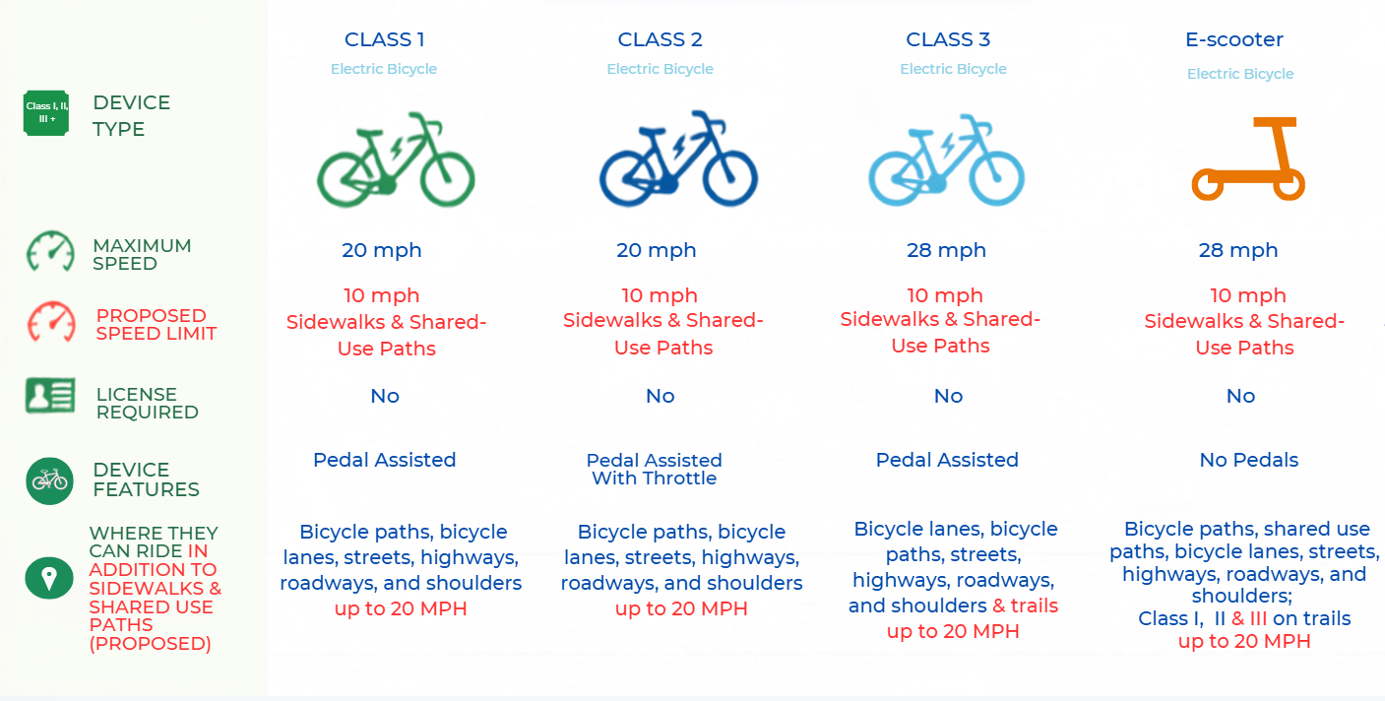
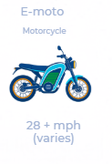
Background and Overview
Summary
Not Micromobility
Notes:
Say: “The proposed ordinance focuses on regulating the operating speed of these devices, regardless of device type or classification, rather than relying solely on the maximum speeds the devices are legally capable of reaching, as shown in the chart before you.“
The proposed changes are that there would be a 10 MPH Speed Limit on Sidewalks and Shared-Use Paths. On all other facilities types, legal e-bikes and e-scooters are limited by their device capability up to 28 miles per hour unless otherwise posted. Further, all micromobility use is subject to careless and reckless operation which means riders must choose a speed appropriate for the conditions and may not endanger other people or property nor interfere with safe travel of others.
"So in summary, the proposed ordinance focuses on regulating the operating speed of these devices, regardless of device type or classification, rather than relying solely on the maximum speeds the devices are legally capable of reaching, as shown in the chart before you.”

